Slide 1
Chinese Character Analysis
Chinese songs

Slide 2

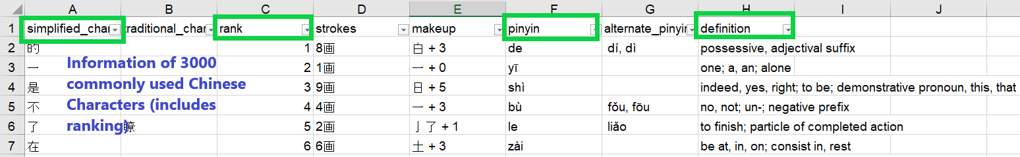
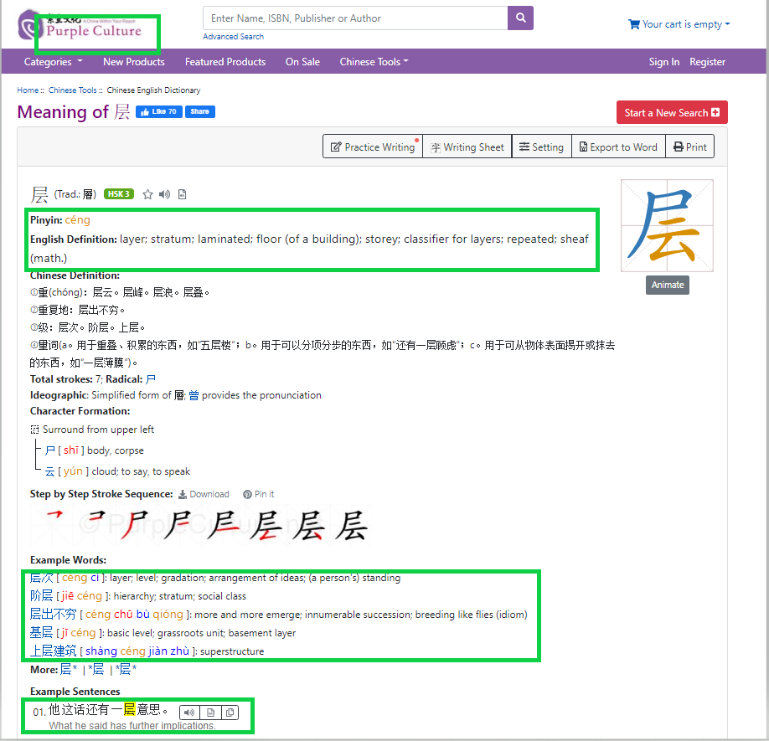
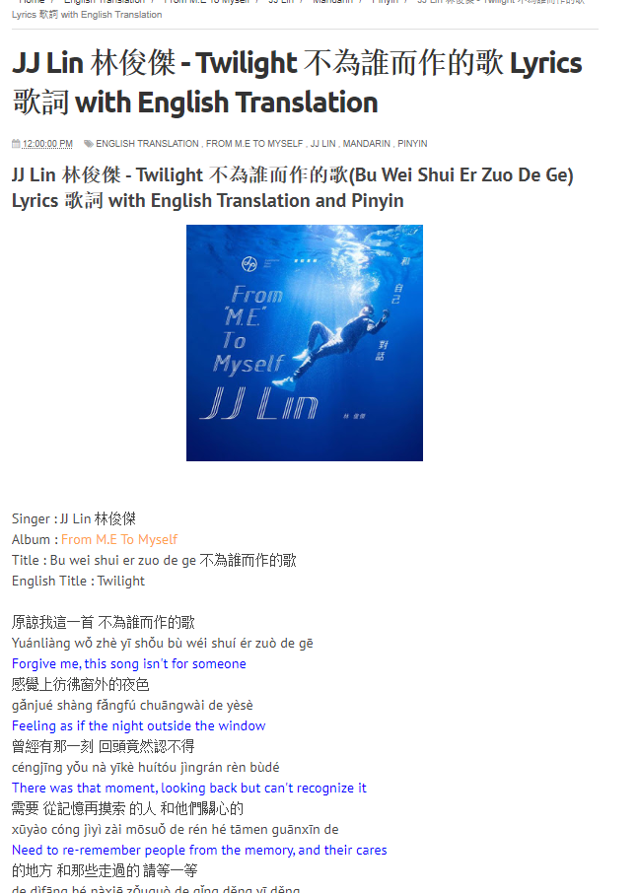
Raw Information Sources
1. Raw file: Excel of 3000 Chinese Words
2. Chinese dictionary website (Purpleculture.net)
3. Chinese song lyrics
(musicacrossasia)

Slide 3
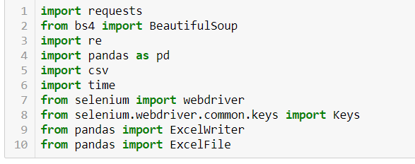
Key Imports

Slide 4
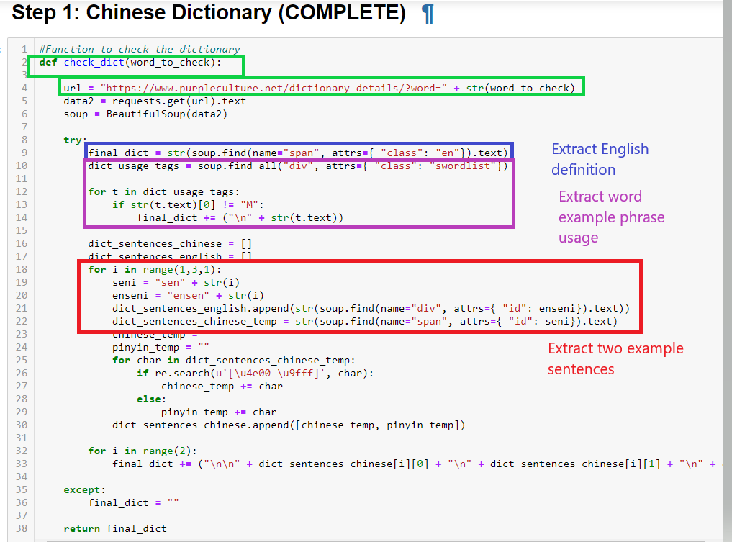

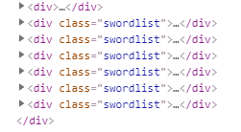

Step 1: Extract 3000 Chinese Dictionary Definitions

Slide 5
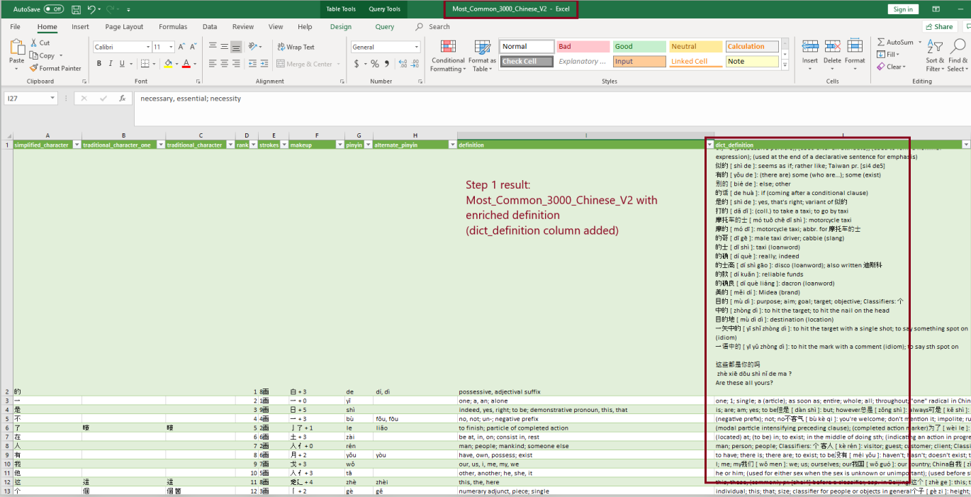
Step 1: Result

Slide 6
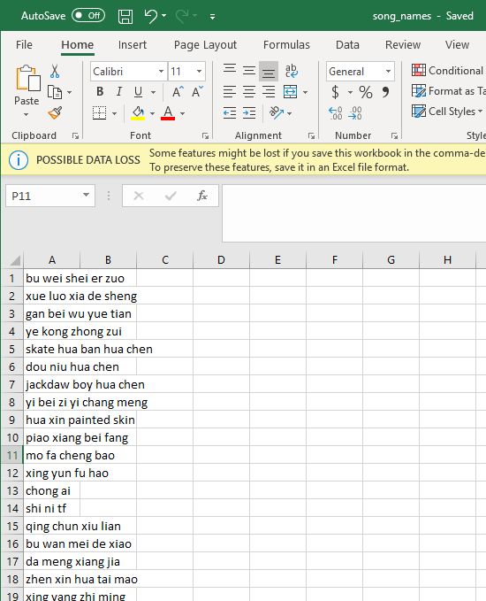
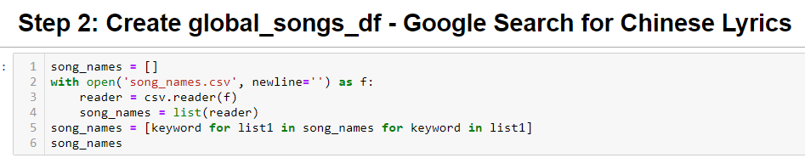
Step 2: Create songs database based on user input
Step 2A: Read user input from csv file
User inputs song names in song_names.csv
Read csv file

Slide 7
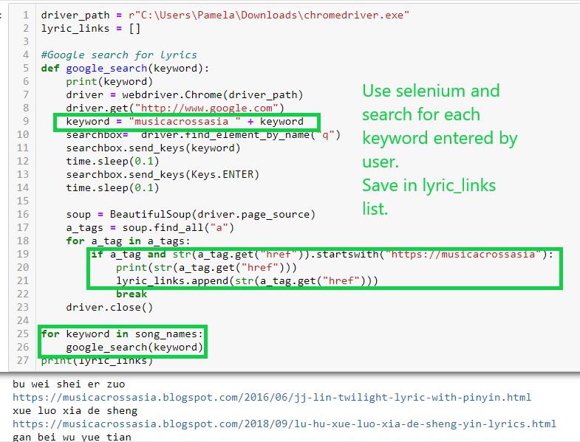
Step 2: Create songs database based on user input
Step 2B: Search for keywords entered by user, save links
Website used to find lyrics is musicacrossasia.blogspot

Slide 8
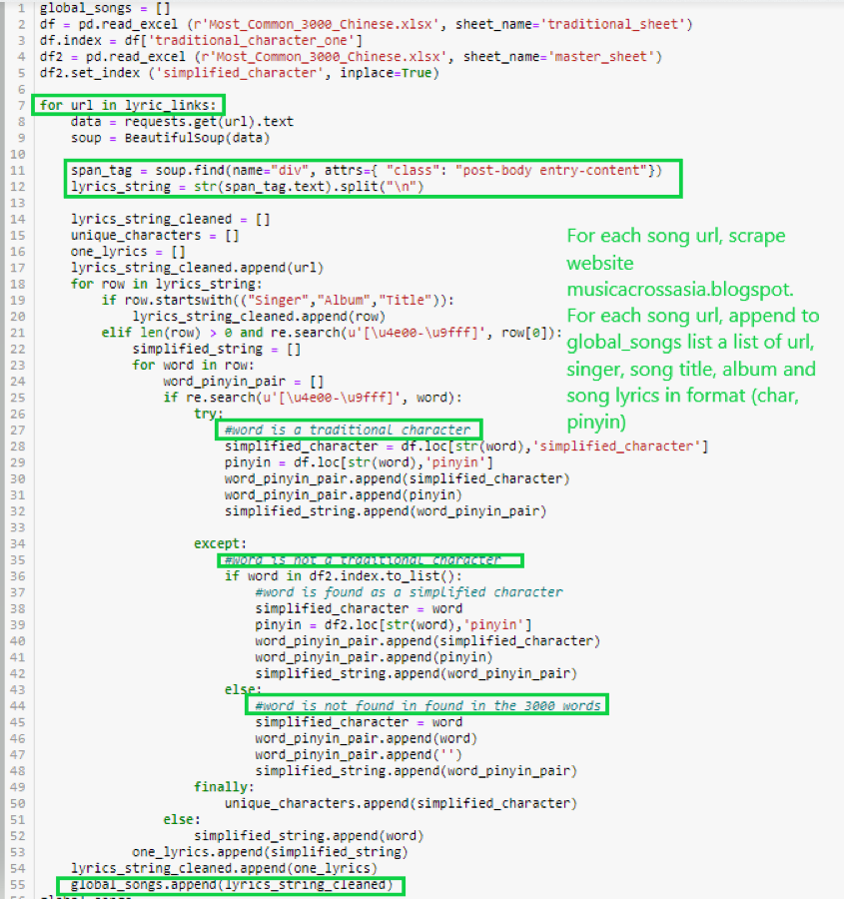
Step 2: Create songs database based on user input
Step 2C: Scrape each song information from url

Slide 9
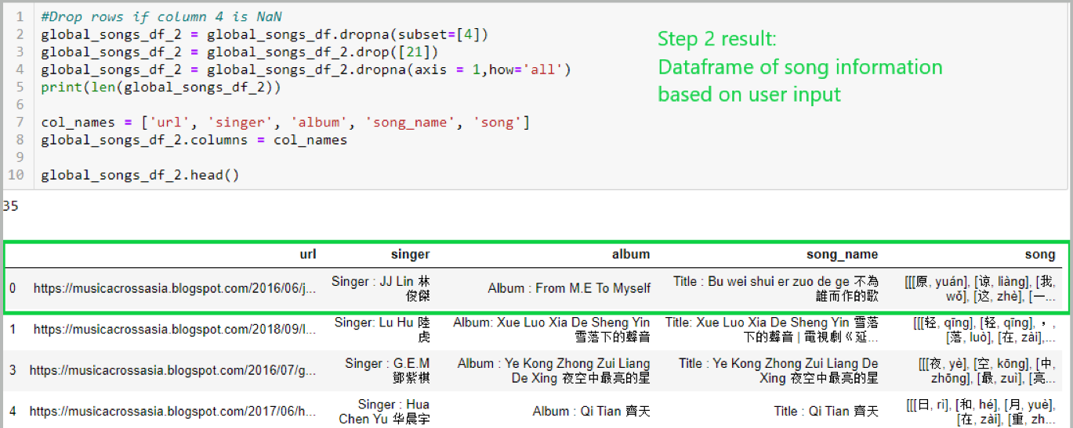
Step 2 Result: Dataframe of song information

Slide 10
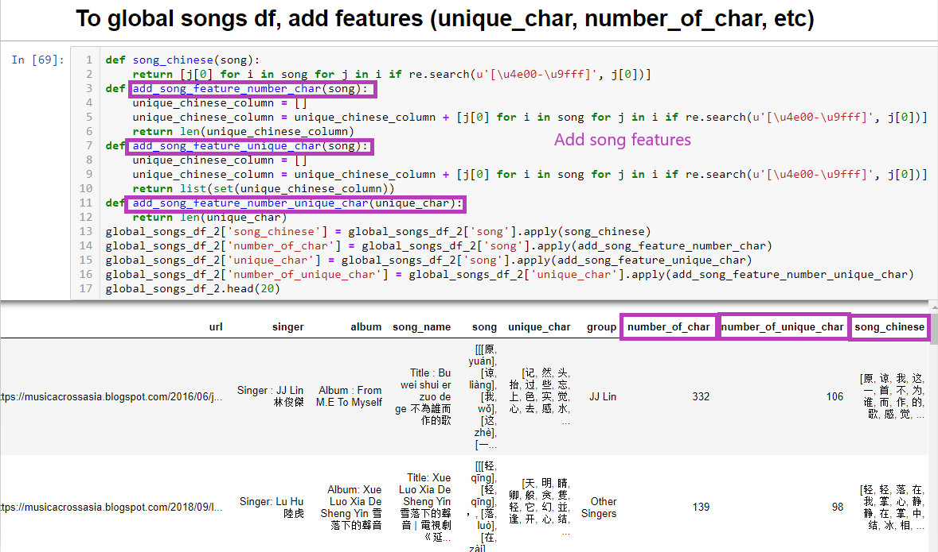
Step 3: Add features to songs Dataframe
Step 3A: Add features per song

Slide 11
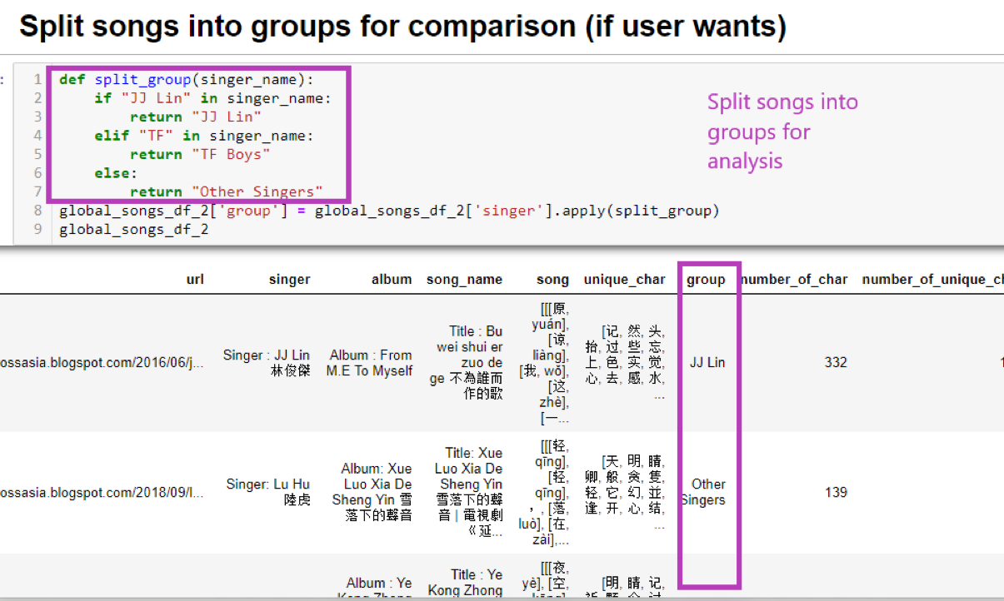
Step 3: Add features to songs Dataframe
Step 3B: Split into groups

Slide 12
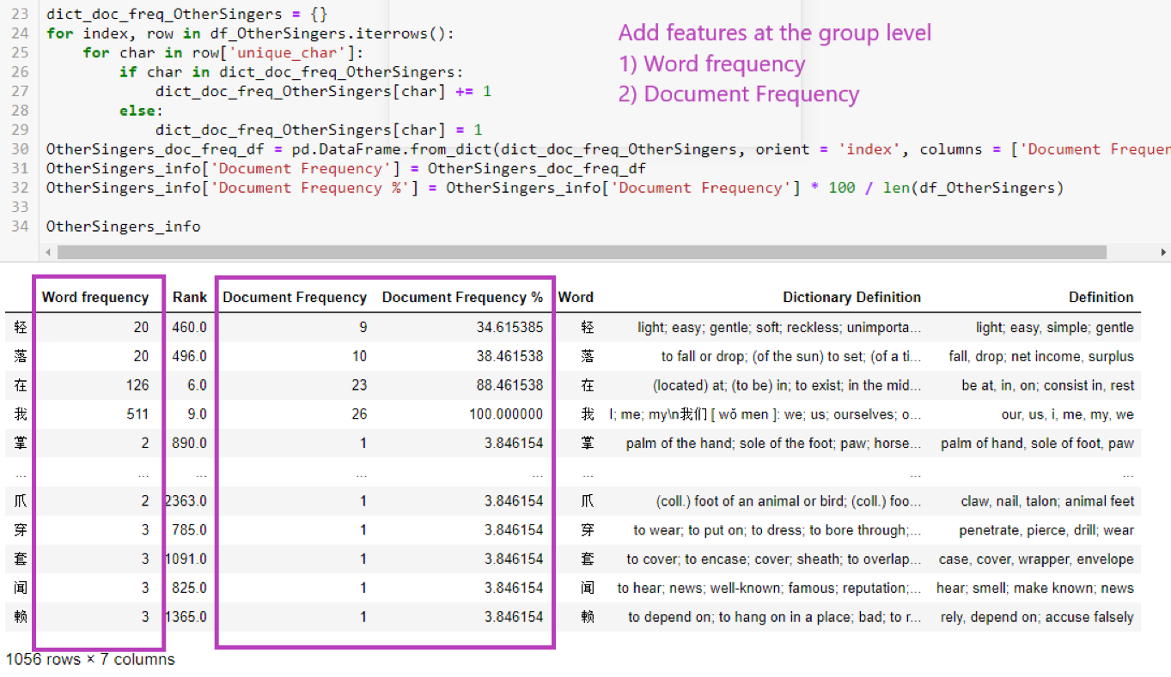
Step 3: Add features to songs Dataframe
Step 3C: Add features at the group level

Slide 13
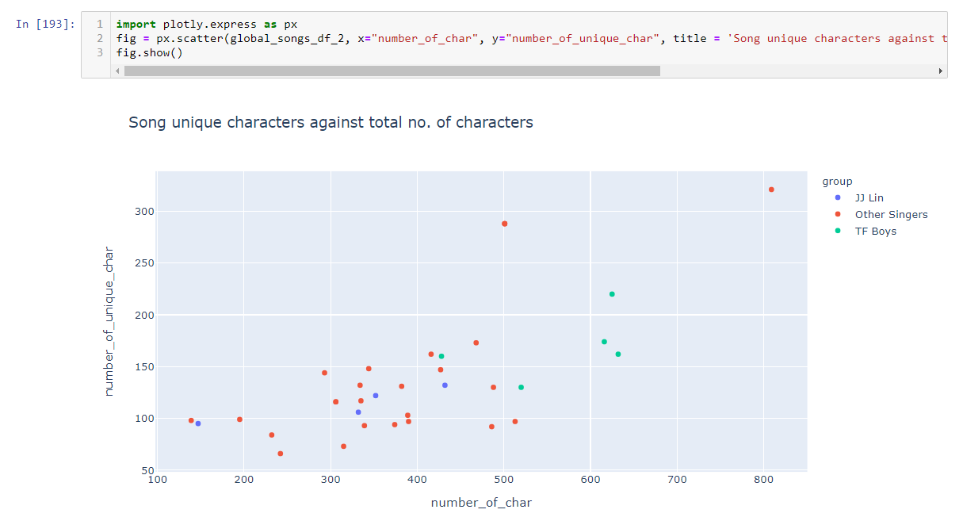
Step 4: Plotting and Visualisation

Slide 14
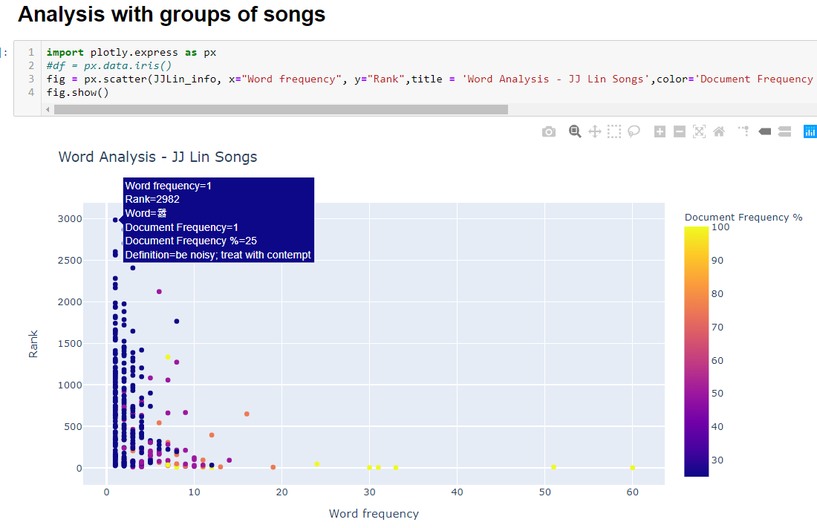
Step 4: Plotting and Visualisation
After adding more features on a group level… Such as document frequency

Slide 15
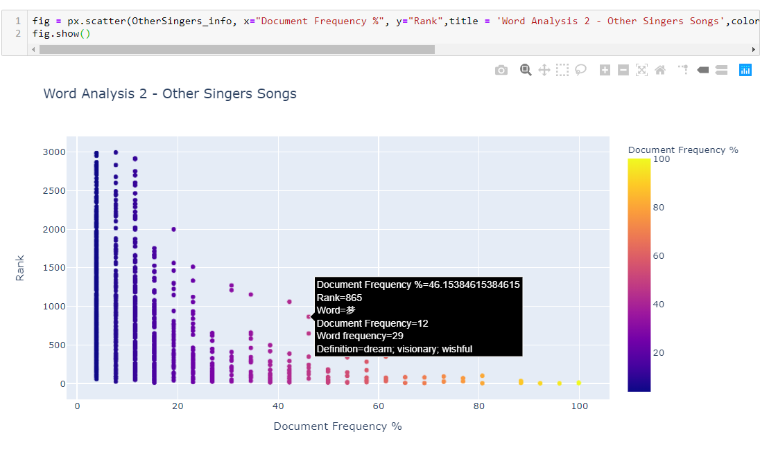
Step 4: Plotting and Visualisation

Slide 16
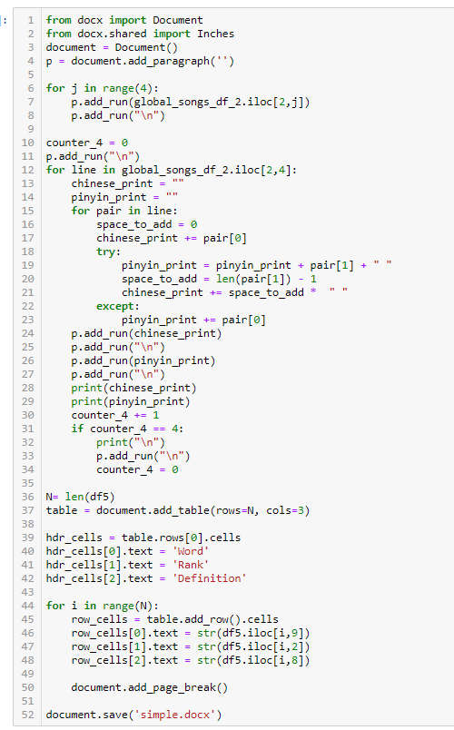
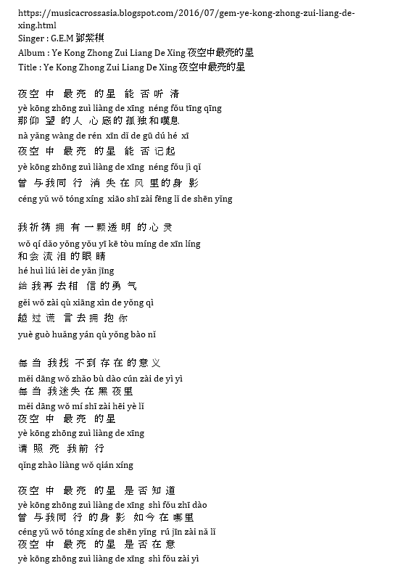
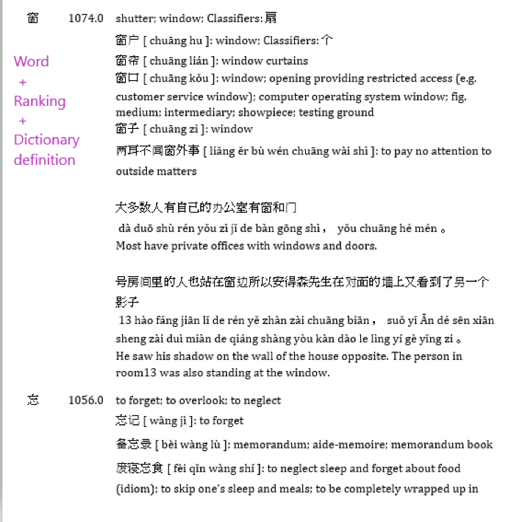
Step 5: Converting stored Dataframe song into printable formatted word document

Slide 17
Looking back / Future improvements
Feature | Current | Improved
3000 Chinese Excel | About 60 words did not yield result from Chinese dictionary website | To troubleshoot – There may be difference in the page source code for these 60 words
Selenium Google search | About 1/3 did not give url result | To find additional alternative Chinese lyrics websites to scrape or user to add in more keywords for each search
Code | Did not always make use of functions, especially in section writing features for groups of Chinese songs | To make code concise by writing functions
Continual additions to database and changes to groups | No feature | To make more user-friendly for continual, longer-term usage
Word document format | Word definition table not able to auto-fit to contents | Auto-fit or change column width – Search for code

